Slide 1


Circuit Lab
Division B/C
Georgia Tech Event Workshop Series 2025-26

Slide 2
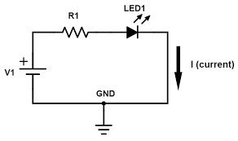
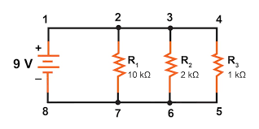
01
Rules Sheet
02
Basic Info
03
Advanced Topics
04
Tips from a Veteran
05
Additional Resources
Notes:
For Builds: Replace difficult topics with physical principles involved in the build and replace common questions with common designs

Slide 3
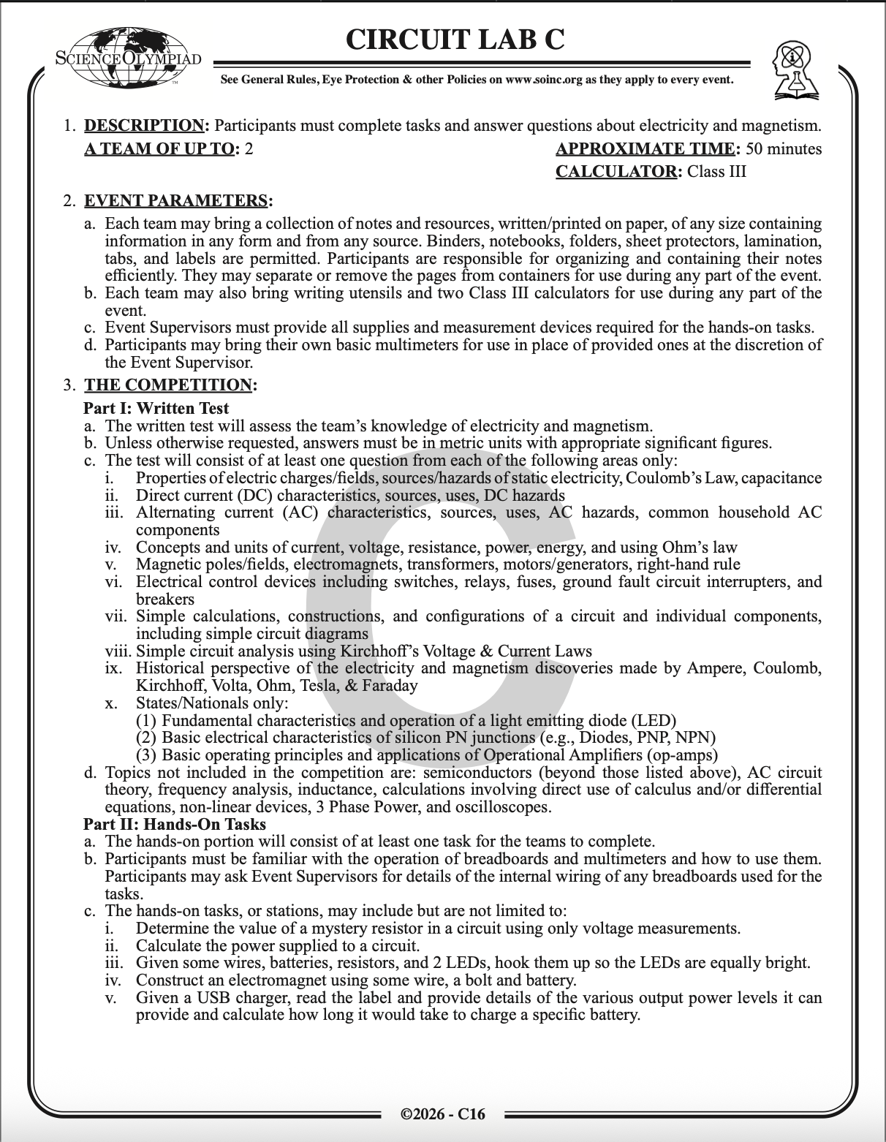
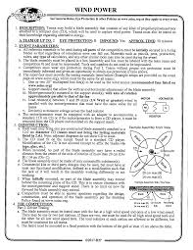
The Rules Sheet
Lab Event: You’ll have both a test and a Lab portion to complete
Test: Focuses mainly on circuits, both conceptually and quantitatively. Includes topics like voltage, current, resistance, capacitance, etc.
Lab: Real-life application of circuit concepts. Can ask you to do any number of things and tests you on your familiarity with components and how they work
Notes:
Highlight key points from the rules sheet: DESIGN LOGS that basically grant free points, most tested-on topics, point distribution so that competitors know what to prioritize, allowed notes and equipment, etc.

Slide 4


Basics
Notes:
This section should focus on topics that are more math-based (harder to self-teach), concepts that come only usually up in college level courses, or concepts that you struggled with when you competed in this event

Slide 5
What is a Circuit?
A circuit is a closed loop that moves electrons through the loop via the use of an electrical energy source.
These loops are usually made of metal wires that connect the ends of the energy source together.
A circuit is “broken” when there is no longer a closed path for the electrons to travel, resulting in the flow of electrons being halted.
Circuits usually have three main qualities: voltage, current, and resistance.

Slide 6
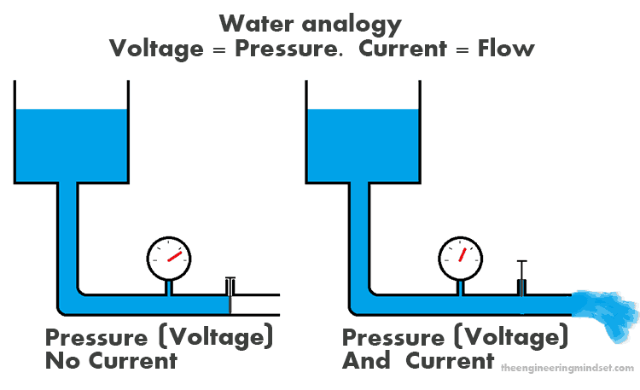
Voltage & Current
The voltage of a battery describes the difference in energy between the positive and negative terminals of the battery. That difference in energy, is what creates the current that runs through the circuit
Current is measure of the flow of charge in a circuit.
You can think of voltage like the water pressure in a tank and current like the flow of water. The higher the pressure, the faster the water flows.

Slide 7
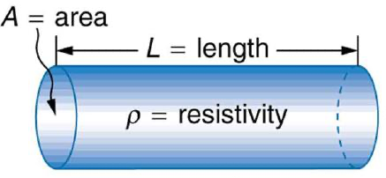
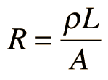
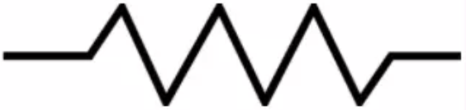
Resistors & Resistance
Resistance is a measure of how much voltage is dissipated by a circuit element when a current is run through it.
Resistors are circuit elements that only have resistance.
The resistance of a resistor can be calculated using the formula:
p is resistivity, a material specific constant, and L and A are length and cross-sectional area of the resistor respectively.
Usually represented by the zig-zag symbol on the right
Resistors control how much current there is for a given voltage

Slide 8
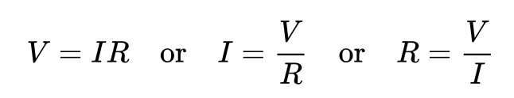
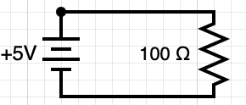
Ohm’s Law
Describes voltage, current, and resistance in equation form.
We can use Ohm’s Law to find the current of the circuit. I = V/R = 5/100 = 0.05 A

Slide 9
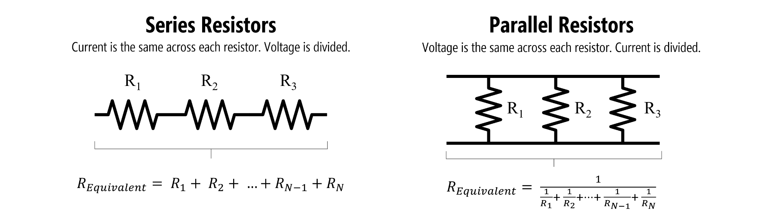
Equivalent Resistance
Resistors can be configured in multiple ways. Instead of having to think about each resistor independently, we can combine the resistors into one resistor with an equivalent resistance to the whole configuration

Slide 10
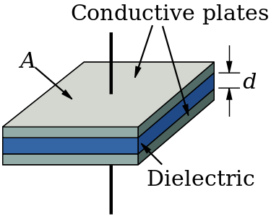
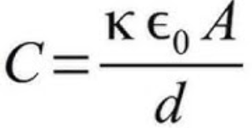
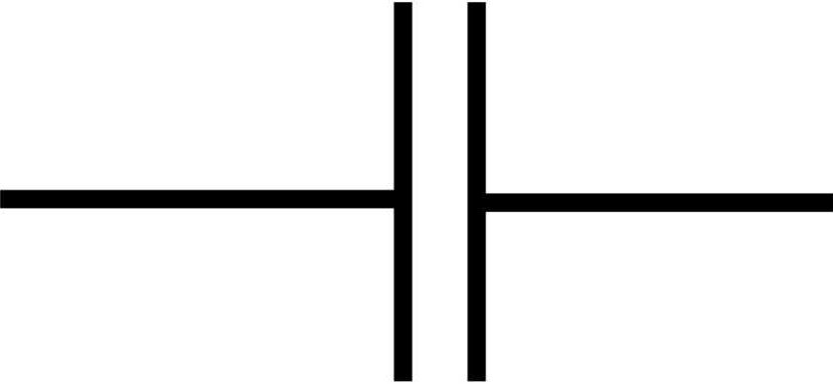
Capacitors & Capacitance
Capacitance is defined as the amount of charge an element can hold per volt applied to the element.
This can be expressed as C = Q/V where C is capacitance, Q is charge, and V is voltage.
A circuit element that has only has capacitance is called a capacitor.
The capacitance of a capacitor can be determined by the equation:
κ is the material-specific dielectric constant, 𝜖₀ is the universal constant vacuum permittivity, A is the area of the capacitor plates, and d is the distance between the plates
The symbol on the bottom left commonly represents capacitors in circuits.

Slide 11
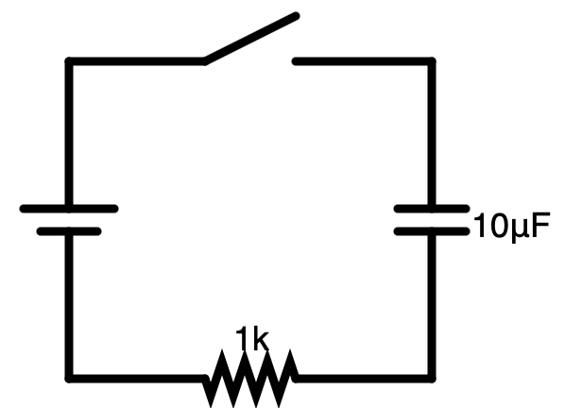
Capacitors (cont.)
In circuits, capacitors introduce the dimension of time to our circuit.
Upon closing the switch, the capacitor will act like a plain wire, letting the current flow as if it wasn’t even there.
As time passes, the battery will charge up the capacitor, giving it a voltage that resists the voltage of the battery. This makes the current decrease.
After the switch has been closed for a long time, the capacitor will act like an open switch and the current will be zero.

Slide 12
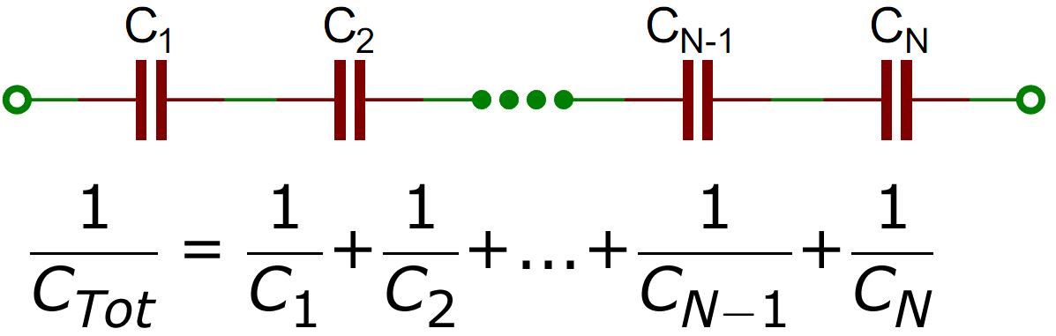
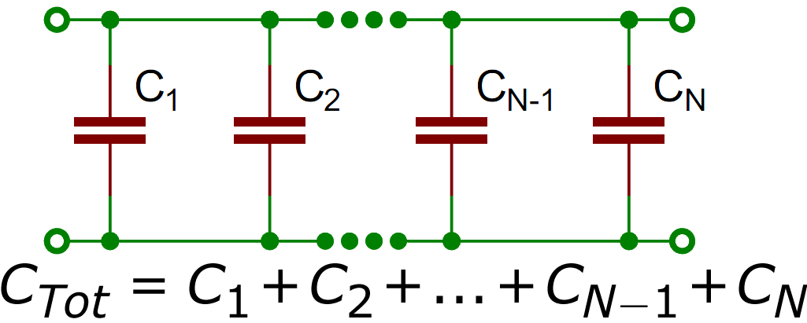
Equivalent Capacitance
Just like resistors, capacitors can be configured in multiple ways and simplified into one capacitor, making it easier to understand how a circuit functions.
Series Capacitors
Parallel Capacitors

Slide 13
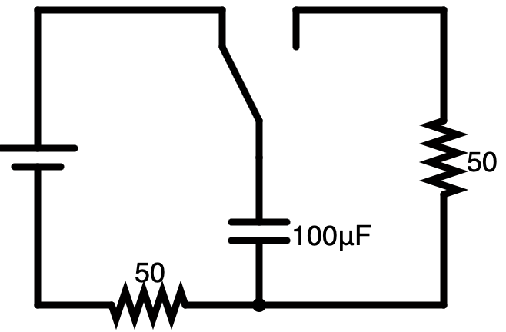
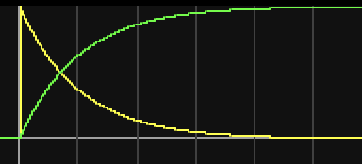
RC Circuits (Charging)
At t=0, the switch is closed, and current starts flowing through the left loop. The current is equal to the current of the system if there was no capacitor, and the voltage of the capacitor is zero.
As time passes, the voltage across the capacitor increases, counteracting the voltage of the battery. This causes a decrease in the current of the circuit.
As t approaches infinity, the voltage of the capacitor approaches the voltage of the battery and the current of the circuit approaches zero.
The yellow graph depicts the current and the green graph depicts the voltage of the battery as time passes.

Slide 14
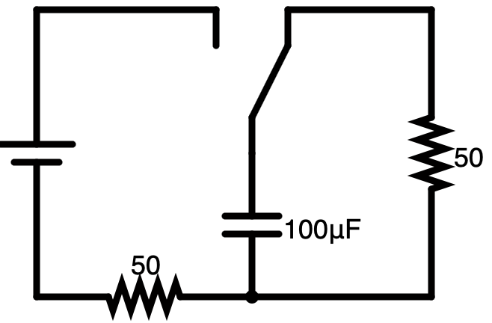
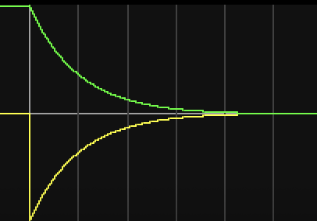
RC Circuits (Discharging)
Once the capacitor is fully charged from the previous example, the switch is flipped at t=t₀, discharging the capacitor.
The current of the loop jumps to the maximum current possible for the circuit and the voltage starts decreasing.
As the voltage decreases, there is less energy causing the current, making the current decrease in magnitude as well.
After a long time, the capacitor has fully discharged, leaving both voltage and current at zero.

Slide 15
Advanced Topics
Notes:
This section should focus on topics that are more math-based (harder to self-teach), concepts that come only usually up in college level courses, or concepts that you struggled with when you competed in this event

Slide 16
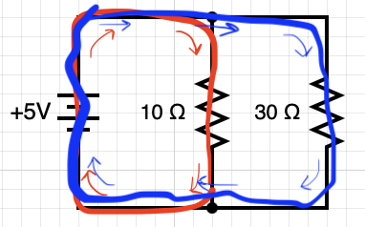
Kirchhoff’s Voltage Law
Also known as: KVL, Loop Law
Says the sum of voltages in a closed loop equals 0.
∑V = 0
Ex: Red loop
∑V = V_{b} - V_{R1} = 0
V_{b} = 5, V_{R1} = (10)(I2)
∑V = 5 - (10)(I2) = 0
I2 = 5/10 = 0.5 A
Ex: Blue loop
∑V = V_{b} - V_{R2} = 0
V_{b} = 5, V_{R2} = (30)(I3)
∑V = 5 - (30)(I3) = 0
I2 = 5/30 = 0.166 A

Slide 17
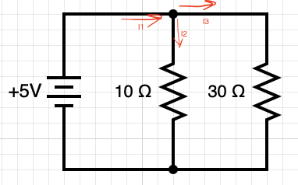
Kirchhoff’s Current Law
Also known as: KCL, Junction Law
States the sum of currents at a junction equals 0
∑I = 0
Example:
∑I = ∑I_{in}- ∑I_{out}= 0
∑I_{in} = I1
∑I_{out} = I2 + I3
∑I = ∑I_{in}- ∑I_{out}= I1 - I2 - I3 = 0 → I1 = I2 + I3
Using the values of I2 and I3 from the previous problem, we get I1 = 0.666 A

Slide 18
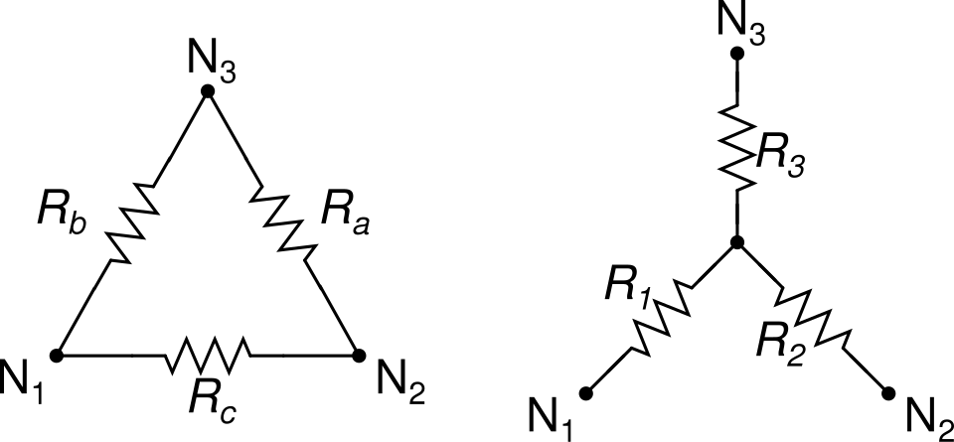
Delta-Wye Transformation
Not all resistor circuits can be easily simplified using just series and parallel equivalence. The Delta-Wye Transformation helps us simplify circuits that would be a pain to simplify otherwise.
It has two forms: Delta-Wye and Wye-Delta.

Slide 19
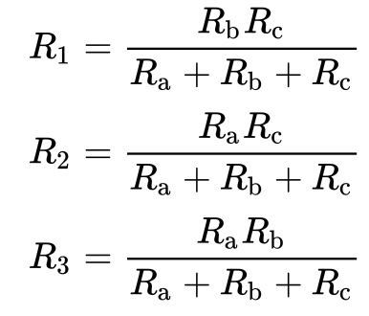
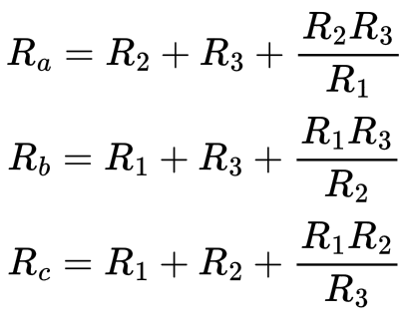
Delta-Wye Transformation
Delta-Wye Equations:
Wye-Delta Equations:

Slide 20
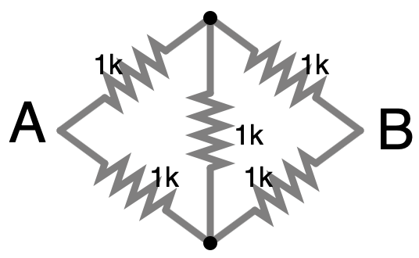
Delta-Wye Transformation

Slide 21
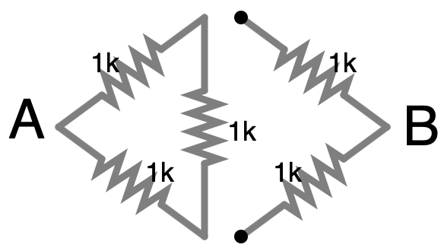
Delta-Wye Transformation

Slide 22
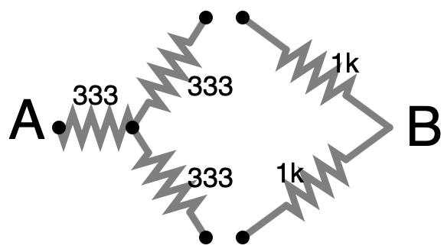
Delta-Wye Transformation
R2
R1
R3

Slide 23
Delta-Wye Transformation
R1 = R2 = R3 = (1k)(1k)/3k
(1k)(1k)/3k = 1k/3 ~ 333

Slide 24
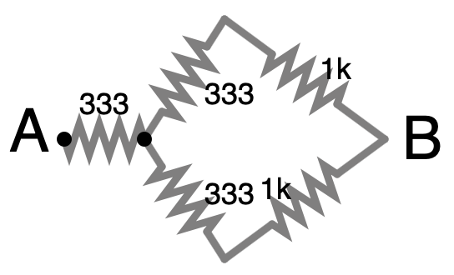
Delta-Wye Transformation

Slide 25
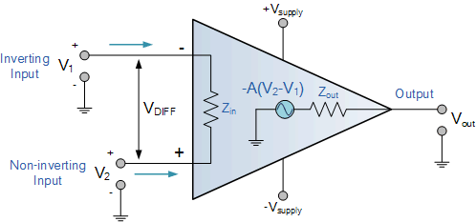
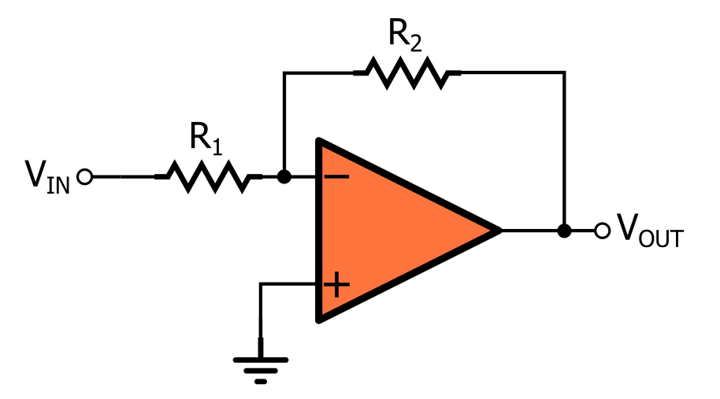
Op-Amps (Div C Only)
Changes output depending on the configuration
In open-loop configuration, V_{out} = A(V₂- V₁), where A is the gain
In closed-loop configurations, V_{out} changes depending on the specific configuration.
Ideal op-amps have 4 assumptions:
Infinite gain in open-loop configuration
Infinite resistance at the inputs
Zero resistance at the output
In closed-loop configs, inputs are equal

Slide 26
Tips from a Veteran
Practice Tests:
Take lots and lots of practice tests! As the season progresses, more and more invites will publicly release their test sets. Use them! Consistently practicing and learning from those tests is the best way to get better at the test portion.
Lab Portion:
This is where the circuit analysis and component knowledge from the test come into play. Be very familiar with different component configurations as well as analysis methods like Kirchoff’s Law.
Notes:
Use this section to talk about any strategies you used to navigate the event when you competed. For example, how did you manage your time, how did you organize your notes, how did you split topics up between you and your partner, etc.?

Slide 27
Additional Resources
AllAboutCircuits.com
falstad.com/circuit
SUBWAY STATIONS
Organic Chemistry Tutor
Scioly Wiki Circuit Lab Page
Yes, Saturn is the ringed one. This planet is a gas giant, and it’s composed mostly of hydrogen and helium
Notes:
Here, you can link or mention any online or book resources that helped you in this event when you were a competitor. Try to avoid general resources like scioly wiki, because they probably already are familiar with it.

Slide 28
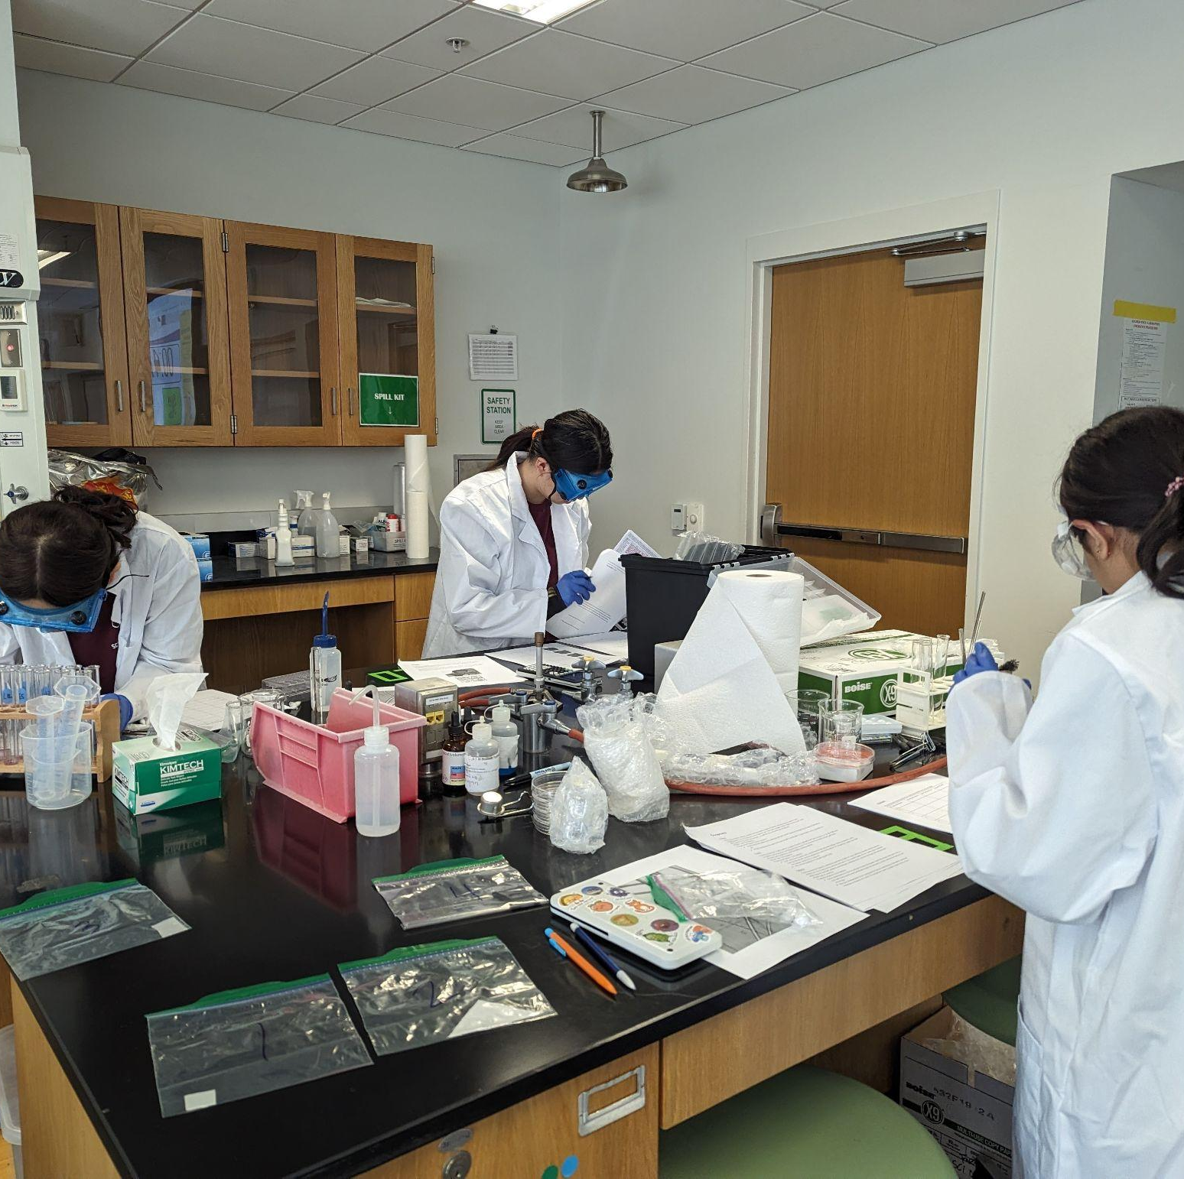
THANKS!
Notes:
(replace picture with a picture from one of our tournaments)

Slide 29


COMMON QUESTIONS
All of the following questions have been pulled from past YJI exams (which can be found on our website) or the Text Exchange on SciOly Wiki
Notes:
\

Slide 30
Question 1
Add text here
Notes:
Pull some questions from exams on the scioly wiki test exchange, first give attendees a couple minutes to read over them/work through them, then walk them through the answers. Try to get a mix of multiple choice and short answer or matching

Slide 31
Question 2
Add text here
Notes:
Pull some questions from exams on the scioly wiki test exchange, first give attendees a couple minutes to read over them/work through them, then walk them through the answers

Slide 32
Question 3
Add text here
Notes:
Pull some questions from exams on the scioly wiki test exchange, first give attendees a couple minutes to read over them/work through them, then walk them through the answers

